Slide 1

Applied Numerical Methods with MATLAB® for Engineers and Scientists 4th Edition
Steven C. Chapra
PowerPoints organized by Dr. Michael R. Gustafson II, Duke University and Prof. Steve Chapra, Tufts University
©McGraw-Hill Education. All rights reserved. Authorized only for instructor use in the classroom. No reproduction or further distribution permitted without the prior written consent of McGraw-Hill Education.

Slide 2
Part 3 Chapter 13
Eigenvalues

Slide 3
Chapter Objectives
Understanding the mathematical definition of eigenvalues and eigenvectors.
Understanding the physical interpretation of eigenvalues and eigenvectors within the context of engineering systems that vibrate or oscillate.
Knowing how to use and interpret MATLAB’s eig function.

Slide 4
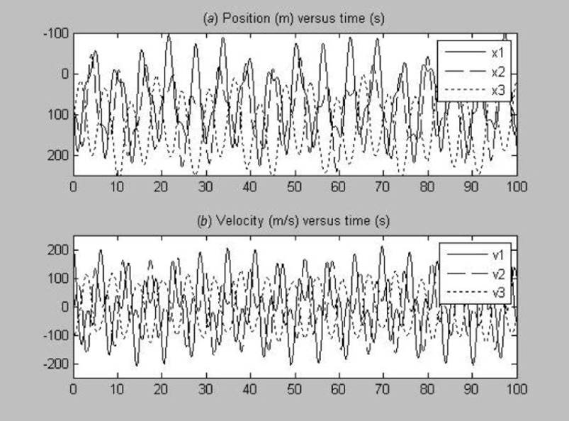
Dynamics of Three Coupled Bungee Jumpers in Time
Is there an underlying pattern???

Slide 5
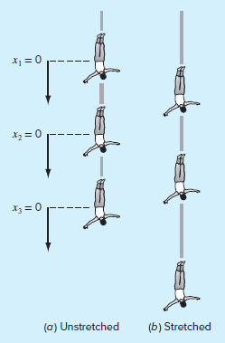
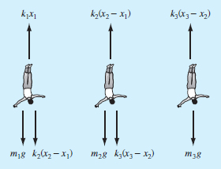
Dynamics of Three Coupled Bungee Jumpers in Time
Is there an underlying pattern?

Slide 6
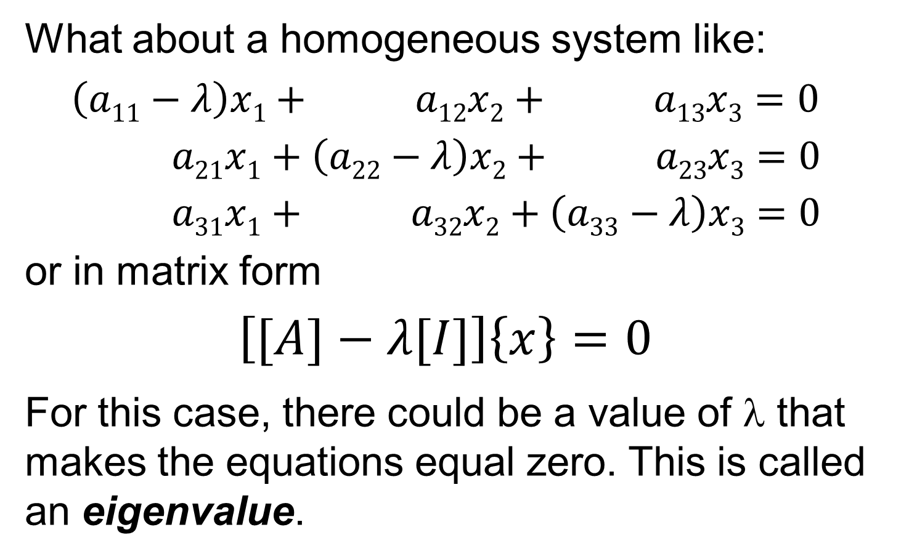
Mathematics, 2
What about a homogeneous system like:
$$\left(a11−λ\right)x1+ a12x2+ a13x3=0$$
$a21x1+\left(a22−λ\right)x2+ a23x3=0$
$a31x1+ a32x2+\left(a33−λ\right)x3=0$
or in matrix form
$$\left[[A]−λ[I]\right]\left\{x\right\}=0$$
For this case, there could be a value of λ that makes the equations equal zero. This is called an eigenvalue.

Slide 7
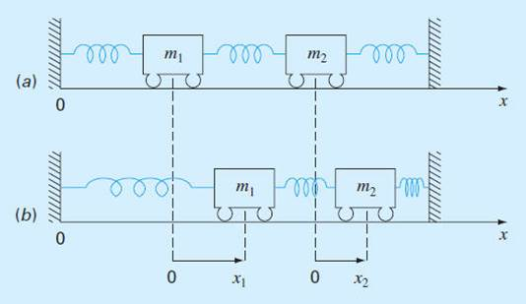
Physical Background: Oscillations or Vibrations of Mass-Spring Systems

Slide 8
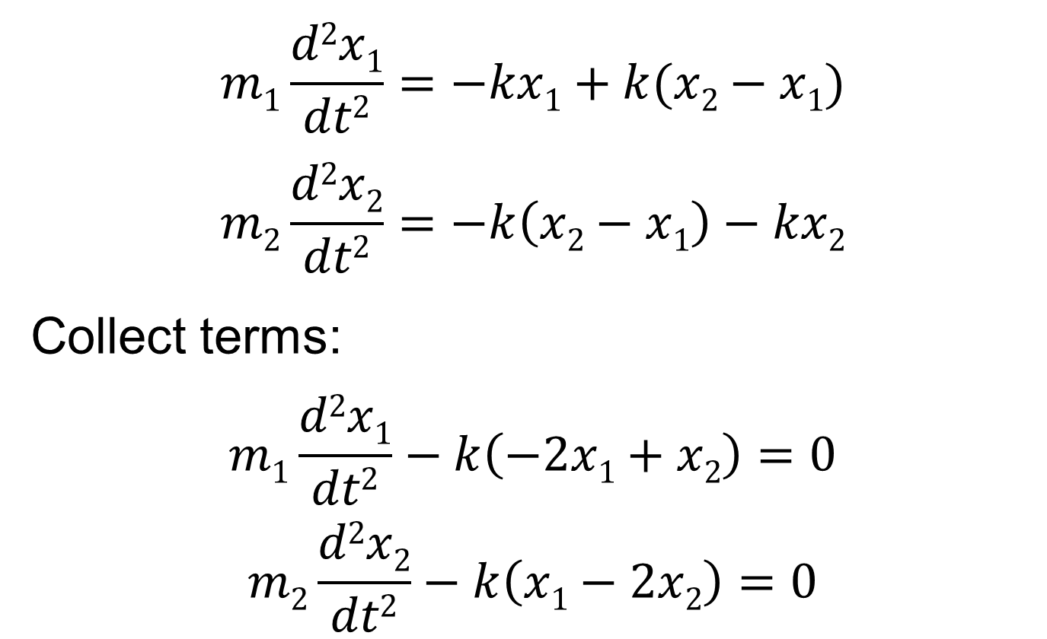
Model With Force Balances (AKA: F = ma)
$$m1\frac{d2x1}{dt2}=−kx1+k(x2−x1)$$
$$m2\frac{d2x2}{dt2}=−k\left(x2−x1\right)−kx2$$
Collect terms:
$$m1\frac{d2x1}{dt2}−k\left(−2x1+x2\right)=0$$
$$m2\frac{d2x2}{dt2}−k\left(x1−2x2\right)=0$$

Slide 9
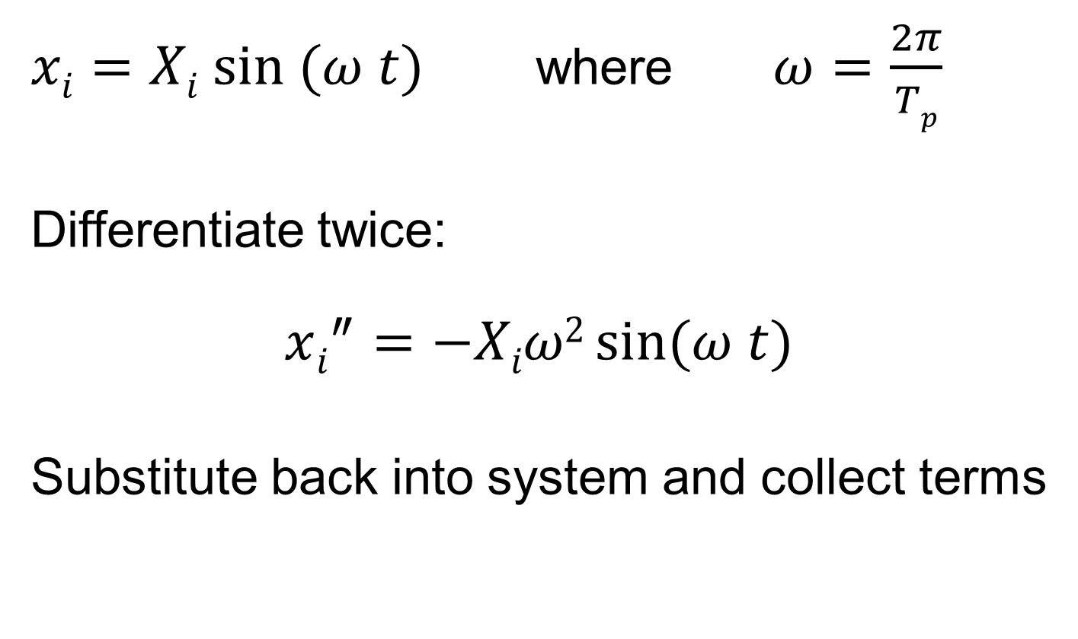
Assume a Sinusoidal Solution
$xi=Xi sin (ω t)$ where $ω=\frac{2π}{Tp}$
Differentiate twice:
$$xi^{″}=−Xiω2\sin{(ω t)}$$
Substitute back into system and collect terms

Slide 10
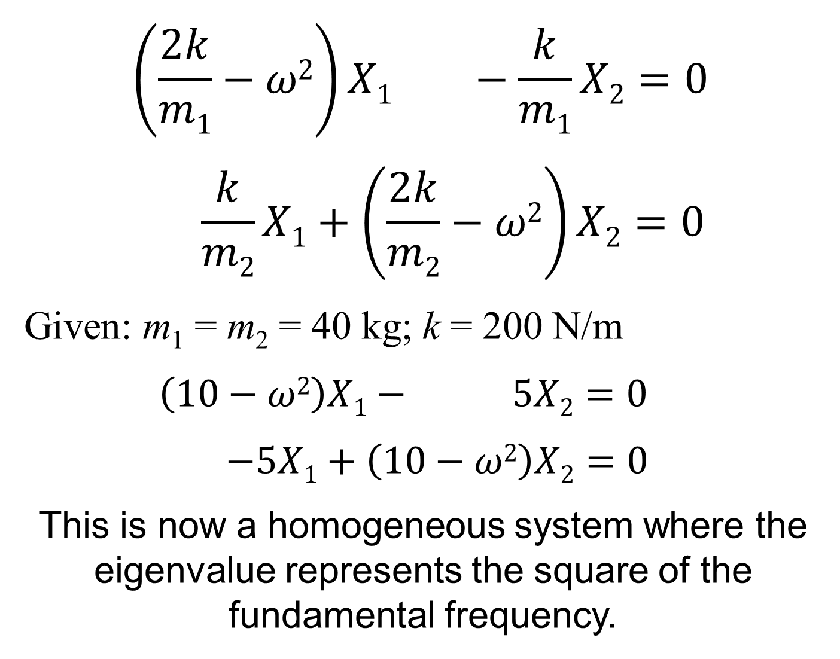
$$\left(\frac{2k}{m1}−ω2\right)X1 −\frac{k}{m1}X2=0$$
$$\frac{k}{m2}X1+\left(\frac{2k}{m2}−ω2\right)X2=0$$
Given: m₁ = m₂ = 40 kg; k = 200 N/m
$\left(10−ω2\right)X1− 5X2=0$
$−5X1+\left(10−ω2\right)X2=0$
This is now a homogeneous system where the eigenvalue represents the square of the fundamental frequency.

Slide 11
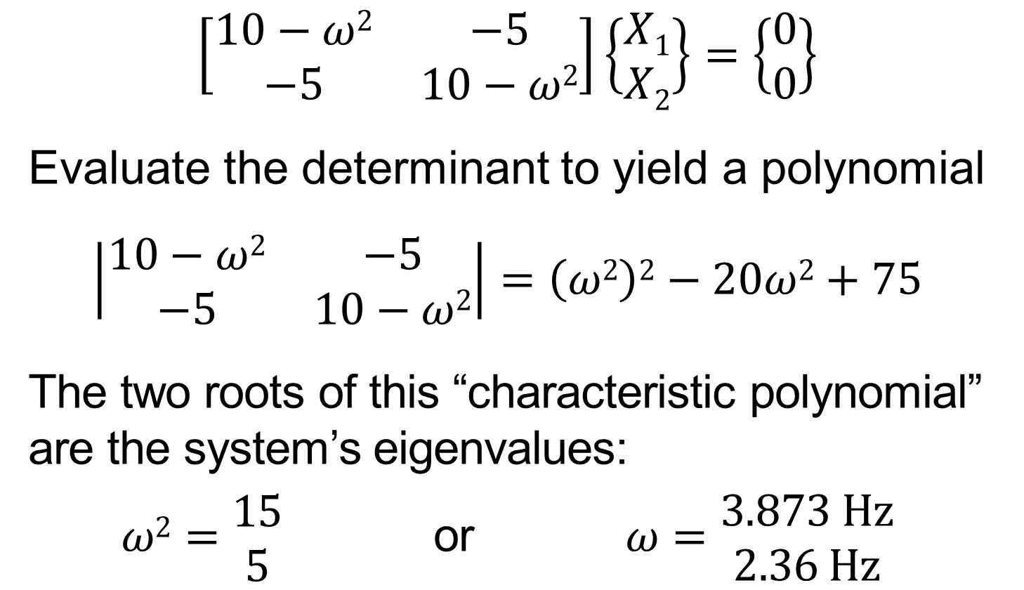
Solution: The Polynomial Method
$$\left[\begin{matrix}10−ω2 & −5 \\ −5 & 10−ω2\end{matrix}\right]\left\{\begin{matrix}X1 \\ X2\end{matrix}\right\}=\left\{\begin{matrix}0 \\ 0\end{matrix}\right\}$$
Evaluate the determinant to yield a polynomial
$$\left|\begin{matrix}10−ω2 & −5 \\ −5 & 10−ω2\end{matrix}\right|=\left(ω2\right)2−20ω2+75$$
The two roots of this “characteristic polynomial” are the system’s eigenvalues:
$ω2=\begin{matrix}15 \\ 5\end{matrix}$ or $ω=\begin{matrix}3.873 Hz \\ 2.36 Hz\end{matrix}$

Slide 12
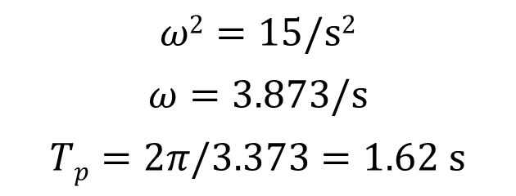
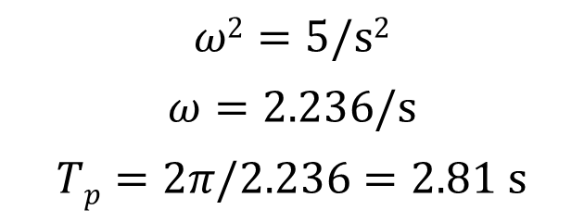
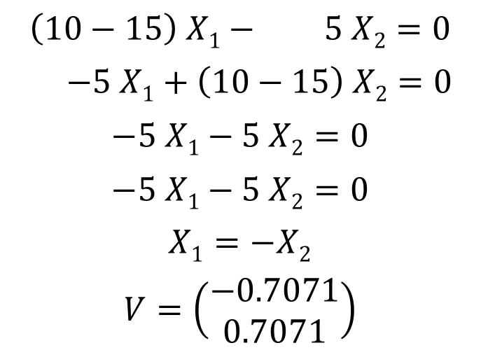
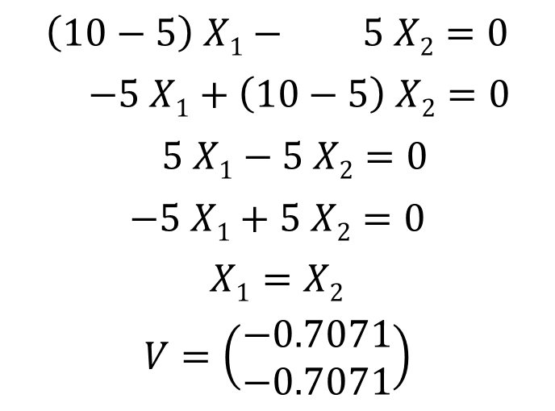
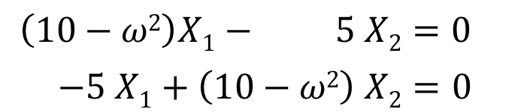
INTERPRETATION
$$ω2=5/s2$$
$$ω=2.236/s$$
$$Tp=2π/2.236=2.81 s$$
$$ω2=15/s2$$
$$ω=3.873/s$$
$$Tp=2π/3.373=1.62 s$$
$$\left(10−ω2\right)X1− 5 X2=0$$
$$−5 X1+\left(10−ω2\right) X2=0$$
$$\left(10−5\right) X1− 5 X2=0$$
$$−5 X1+\left(10−5\right) X2=0$$
$$5 X1−5 X2=0$$
$$−5 X1+5 X2=0$$
$$X1=X2$$
$$V=\left(\begin{matrix}−0.7071 \\ −0.7071\end{matrix}\right)$$
$$\left(10−15\right) X1− 5 X2=0$$
$$−5 X1+\left(10−15\right) X2=0$$
$$−5 X1−5 X2=0$$
$$−5 X1−5 X2=0$$
$$X1=−X2$$
$$V=\left(\begin{matrix}−0.7071 \\ 0.7071\end{matrix}\right)$$

Slide 13
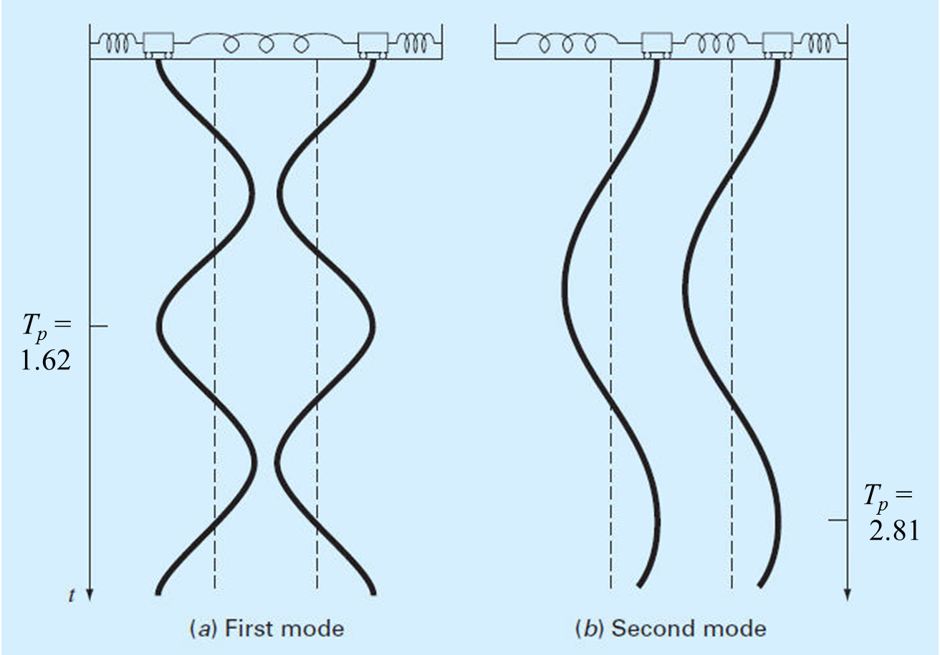
Principle Modes of Vibration, 1

Slide 14
Determining Eigenvalues & Eigenvectors with MATLAB
>> A = [10 -5;-5 10]
A =
10 -5
-5 10
>> [v,lambda] = eig(A)
v =
-0.7071 -0.7071
-0.7071 0.7071
lambda =
5 0
0 15

Slide 15
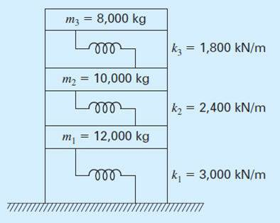
Dynamics of Three Story Building

Slide 16
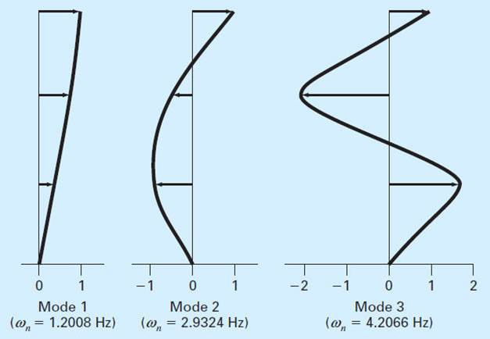
Principle Modes of Vibration, 2

